Slide 1

DATABASE SYSTEMS (EIE36E): SQL – Data Manipulation Language
Doc. Ing. Václav Vostrovský
Ing. Petr Hanzlík

Slide 2

Outline > Data Manipulation Language
Data Manipulation Language
DML - Insert
DML - Update
DML – Delete
DML - Select

Slide 3
SQL: Data Manipulation Language
Data Manipulation Language (DDL) is the part of SQL that governs inserting, updating, deleting, and retrieving data from the database.
This category includes the following statements:
INSERT
UPDATE
DELETE
SELECT

Slide 4
SQL DML: INSERT INTO
The INSERT statement adds new data into a database table
SQL INSER INTO syntax:
INSERT INTO <table_name> [(column_list)]
VALUES (<value_list>);

Slide 5

SQL DML: INSERT INTO example
Add an entity into the table from the last lecture
INSERT INTO customer
VALUES ('ABC1','John Smith','New York','10.30.1982');
SELECT * FROM customer;

Slide 6
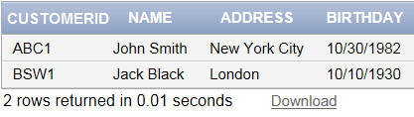
SQL DML: INSERT INTO example
Add an entity into the table from the last lecture
INSERT INTO customer (ADDRESS,NAME,READERID,BIRTHDAY)
VALUES ('London','Jack Black','BSW1','10.10.1930');
SELECT * FROM customer;

Slide 7
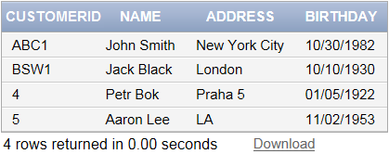
SQL DML: INSERT INTO example
Add 2 entities at once into the table from the last lecture
INSERT ALL
INTO customer VALUES
('4','Petr Bok','Praha','01.05.1922')
INTO customer VALUES
('5','Aaron Lee','LA','11.02.1953')
SELECT * FROM dual;
SELECT * FROM customer;

Slide 8
SQL DML: UPDATE
The UPDATE statement modifies records in a table
SQL UPDATE syntax:
UPDATE <table_name>
SET <column_name> = <column_value>
WHERE <conditions>

Slide 9
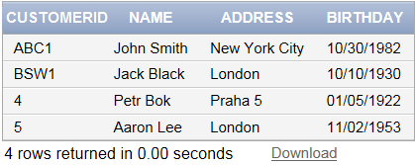
SQL DML: UPDATE example
Update address of Mr. Aaron Lee to London
UPDATE customer SET address = 'London'
WHERE name = 'Aaron Lee';
SELECT * FROM customer;

Slide 10
SQL DML: DELETE
The DELETE statement removes an entity (row) from an existing table.
SQL DELETE syntax:
SQL UPDATE syntax:
DELETE FROM <table_name>
WHERE <conditions>

Slide 11
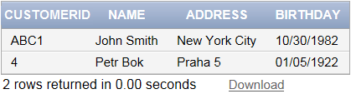
SQL DML: DELETE example
Delete records about all customers from London
DELETE FROM customer
WHERE address ='London';
SELECT * FROM DATABASE;

Slide 12
SQL DML: SELECT
The SELECT statement is used to select data from a database
SQL SELECT syntax:
SELECT <column_name>
FROM <table_name>
[WHERE <where_condition>]

Slide 13
SQL DML: SELECT example
Select all the data contained in a database
SELECT * FROM customer;

